Slide 1
Putting students at the of learning
Sandrine Pac-Kenny
www.lcdsandrine.com
@sandrinepk

Slide 2
Background
Language teacher
Communicative to student centered
From no technology to iPads

Slide 3
Roll call
Pick a topic
Name called
Say one word
Words cannot be repeated
If repeated, person who said it says already said
Notes:
Important to have the already said ; if list small allow one repeat

Slide 4
Learning new vocabulary
A journey of discovery
Taking on your own task
You are in charge of speed, accuracy
Notes:
House; objects

Slide 5
From essay planning…
Group work
Common goal
Equal responsibility
Notes:
Building essay planning

Slide 6
What’s the topic?

Slide 7
Topic : Uniforms in schools are a good idea
Collective thinking
Listening skills
Critical thinking
Speaking skills
Numeracy

Slide 8
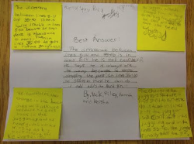
Four corners
Students given a post it
On own: decide Agree / Disagree
One argument
Get back to your group
Stick the post its in corners
Discuss pros and cons
Best argument in the middle

Slide 9
Opinion line
Each group reads out its answer
Go and place themselves on the imaginary line
They may move as other group give their ideas
BUT must always be an unanimous decision

Slide 10
…to writing the essay
Turning mat
Whiteboards
Group work
Reading
Engagement

Slide 11
Argument 1 - for
Argument 2 - for
Introduction:
What is the question?
Where I stand?
Argument 4 - against
Argument 3 - against

Slide 12
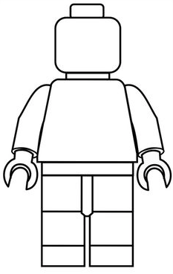
Juniors
Lego man

Slide 13
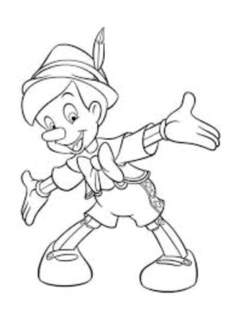
More Italian…

Slide 14
QR Codes
Mystery
Creativity
Personalisation
Differentiation
Get students to make them!
Peer assessment
Revision
Keywords
Questions

Slide 15
Use them to give clues for writing work
Use them with a question on it
Use them to have keywords
Use them to revise focused voca. Like time expressions…

Slide 18
What when…
Early finishers
Stretching

Slide 19
Tweet

Slide 20
Possibilities
Something I learnt today…
Something I now what to explore / learn / research…
My achievement today…
A question I have…
Today has made me want to know about…

Slide 21
Let the dice decide
Paper dice (http://www.toolsforeducators.com/dice/)
Make dice lite app

Slide 22
Nice sticks!
Same idea
The different colours represent different levels
Useful for differentiation
Useful for class levels
Also use for getting involved – have a set numbered
One – 1 in target language and as students come in they take one and get paired randomly.
Notes:
Pairing; word builder; finished early

Slide 23
Example of what you can have on sticks
Write a tweet about today’s lesson
Help a friend (badge)
Look up three new words in relation to topic
Pick up a book
Spelling scribble
Pick a picture and write down as many words as you see
Look for synonyms of 3 words you learnt today
Draw a picture of 5 words you learn today to make an illustrated dictionary etc…

Slide 25
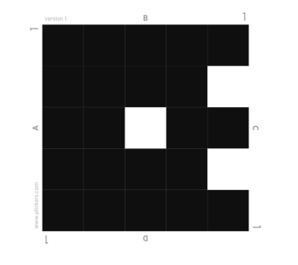
Plickers
AfL tool
Quick feedback
Can be used as assessment too
Personal

Slide 26
Open account
Import your class list
Distribute your plickers
Ask your questions!
Analyse feedback / mark the fill in the gaps

Slide 27
www.lcdsandrine.com @sandrinep

