Slide 1
One year on – what iPads have changed in my classroom
@sandrinepk
www.lcdsandrinepodcasts.com
ICT in Education Conference 2014
Thurles

Slide 2
My background
Started teaching pre Internet
From tape recorders to CD players
Computers in the classroom
Speakers
Interactive Whiteboards
Projectors
iPads were the next best things!

Slide 3
School background
Presentation, Wexford – “e strategy”
E-learning committee
Planning of technology in the school
Involvement of management, staff, parents
Trial with 5th years (6)
7 weeks with set of iPads from Education Centre
2013-2014 – 1st years of iPads for 1st years.

Slide 4
Trial with 5th years
A few students financed the iPad
The school financed the ebooks
What conclusions did I make?
No teacher iPad
It was a book in a different format
Because of small number, could not include it in class planning

Slide 5
Loan of set of iPads
7 weeks with set of iPads from Education Centre
Wifi
Lots of hopes...
1st thing first ! Find apps!
Try websites for learning games, revision games etc

Slide 6
Eventually
Used iPads for:
Research (the gathering)
Recording audio (LC and JC orals)
Use app rover to access flash websites

Slide 7
Conclusions of trial
It was not as good as expected
It was not as good as if students had iPads all the time.
Needed more research to find non language teaching apps and look at how they could be used
Teachers would need one too
Need for mirroring
Need to know what others are doing

Slide 8
2013-2014 – 1st years of iPads for 1st years.
May 2013 – Collection of iPads
Set up with Wriggle (Every student has their own log on user name and password)
Learning the basics skills
Summer 2013 – Wifi arrives
Set of different networks: students; teachers; guest; admin...
Rockus
Fibre broadband (100 mb)

Slide 9
Start of 2013
A few apps downloaded
Books on the iPad
Going paperless
Person in charge of set ups, queries and problems

Slide 10
Beyond 1st years
Wish to use it with all classes
Wish to become mobile in the classroom

Slide 11
Mirroring
4 options
Apple TV – 99€ per room
Reflector – 12.99€ per room
Air Server – 14.99$; Education license cheaper and decreases with numbers
The cable – not mobile
Feedback
Turned to Twitter – good feedback for Reflector and AirServer
Chose AirServer

Slide 12
Air Server
What it does
It mirrors the iPad to the computer (only teacher)
The computer via projector projects the iPad

Slide 13
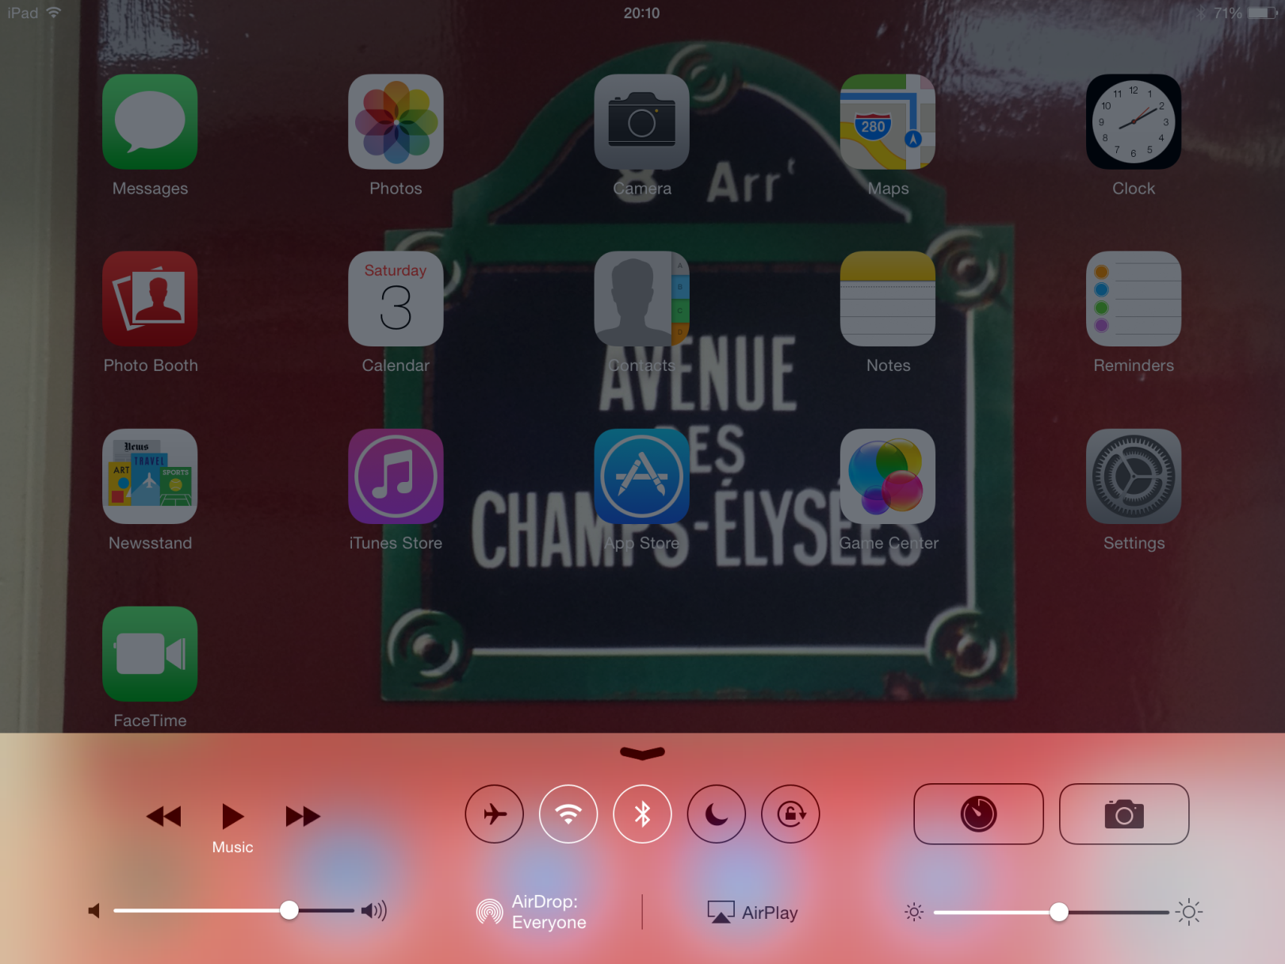

Slide 14
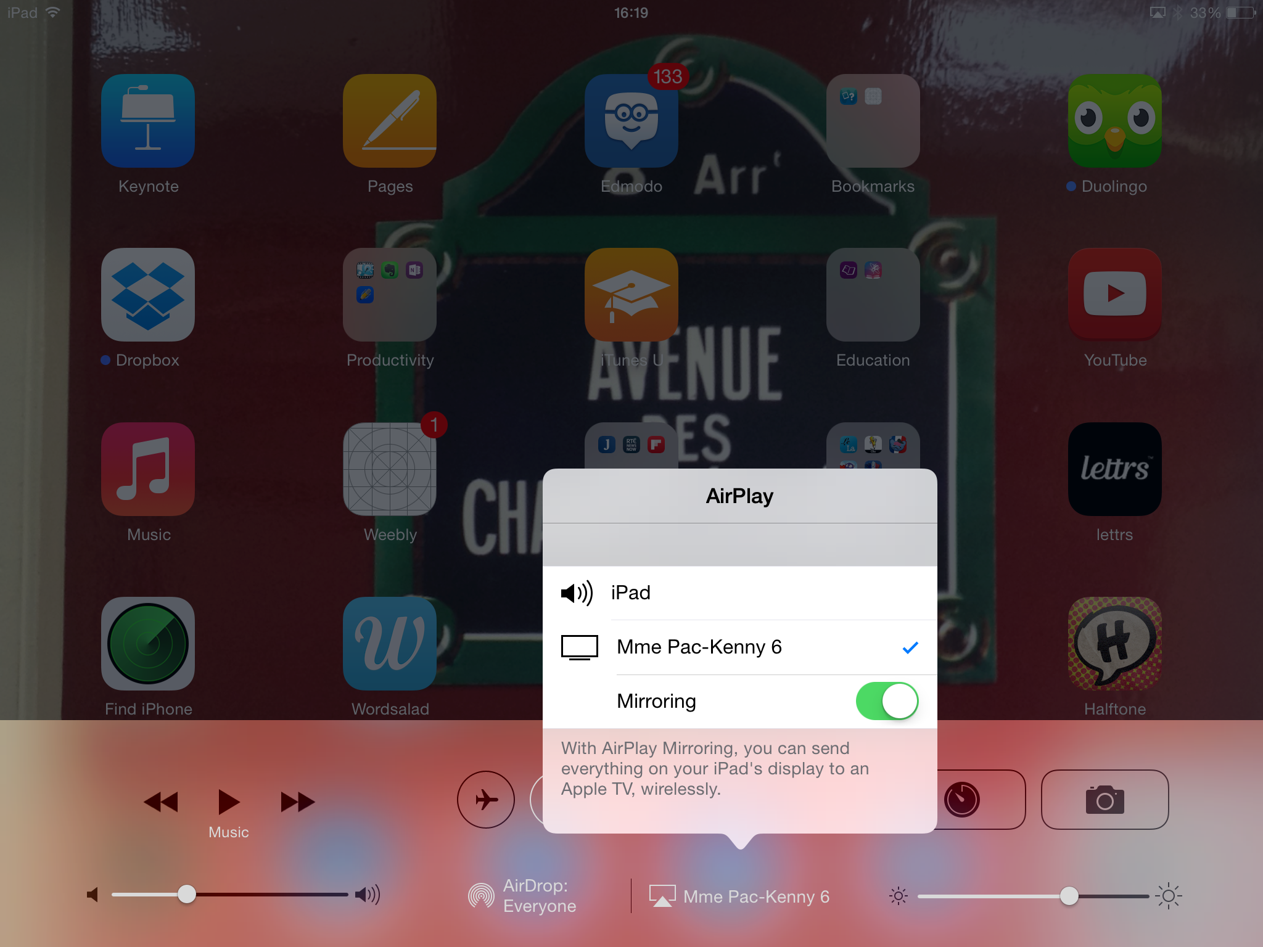

Slide 15
Installation
One computer at a time or one copy on server on network
Wifi needed – iPad and computer on same network
Must have updated flash and java
Less problems with Chrome

Slide 16
Built in features

Slide 17
Camera
Photo shoots (creation; notes)
Videos
Mirror group work live

Slide 18
Notes
Comes with iPad
Note pad
Saves automatically
Use it for taking notes at meeting and CPD

Slide 19
Messages
Instant messaging
Communication colleagues / office
Be sure to have notification off

Slide 20
Clock
Use the timer
Mirror
Students can use own

Slide 21
Apps which work for me !

Slide 22
Keynote
Now comes free
Powerpoint equivalent
You can view PPT made from microsoft office
Create PPT

Slide 23
Uses a folder system for storage.

Slide 24
Uses
Project my presentation
Mobile
Iphone can also be used as remote – Keynote Remote app

Slide 25
Pages
Now comes free
Word equivalent
You can view word document made from microsoft office and other word processing applications
Create documents

Slide 26
Uses
For notes
To open documents from students
To project a test (via Air server)

Slide 27
Edmodo
Free app
Also on website
Not as good as the website
Upgrades made but still not ok to use solely from teacher point of view
Good to send notes / homework live

Slide 28
Dropbox
Cloud storage
Share documents
Free up to certain capacity
Invite friends / multiple emails to gain more space
Storage can be bought
Downloads directly to Keynote / Pages / Photos...

Slide 29
Youtube
Free
Same usage as with a computer except you are mobile
Preparation in advance with
Watch later
Playlists

Slide 30
Explain everything
Free
A note pad
With recording feature (audio and video)
Import files from camera, youtube etc...
Good for flipped classroom
Export to youtube etc...
Good for students to submit a project
A lot of features, could be challenging for first year

Slide 31
Evernote
Free
A note taking
Never used it

Slide 32
Notability
Review on lcdsandrinepodcasts.com
Not free (eventhough has been free when app of the week)
Note pad app
Students are using it
Very easy note taking (similar to Word)
The pluses: the microphone; the folders

Slide 33
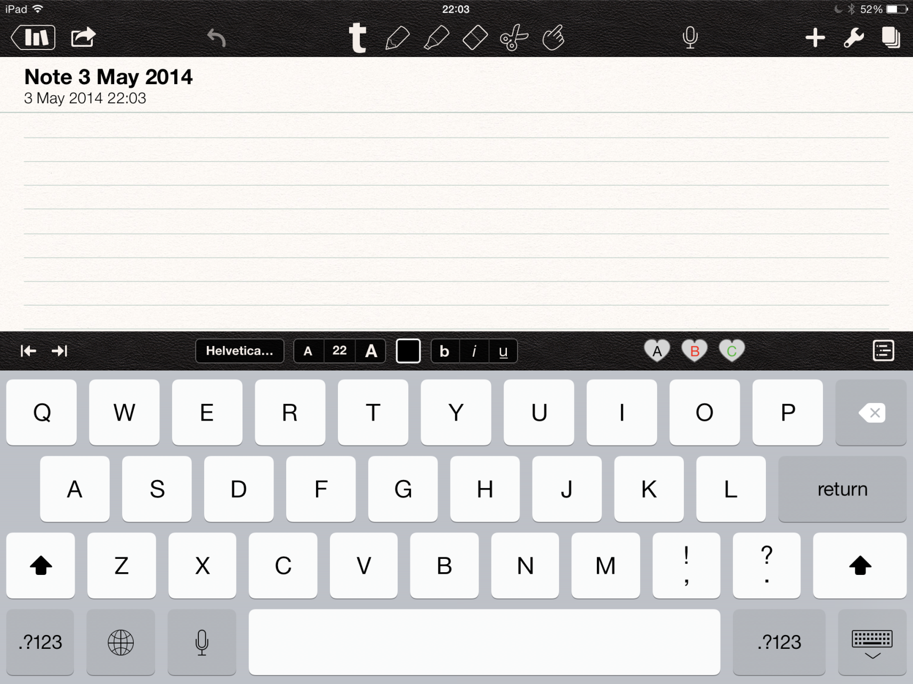

Slide 34
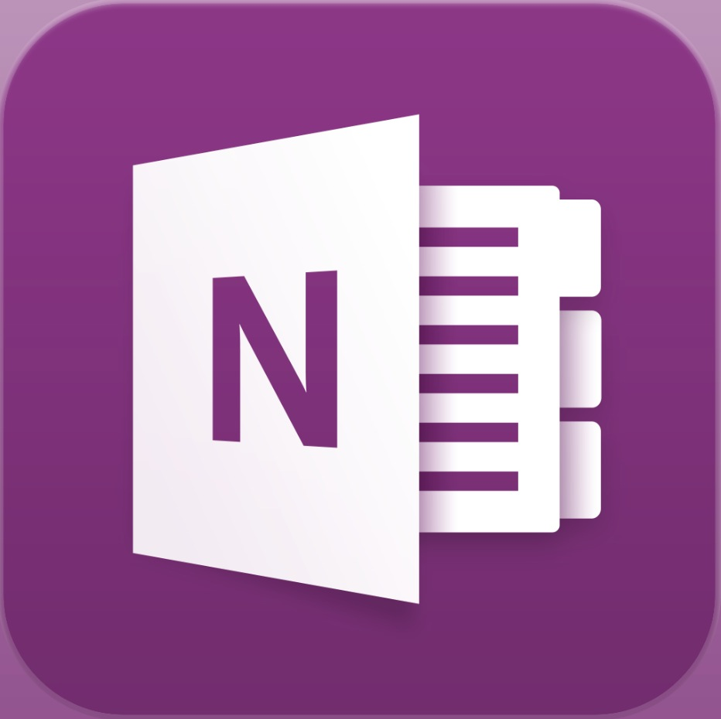
OneNote
Note taking app
Free
Very similar to word
Documents saved under “notebook”
Connects to Skydrive
Lots of potential – but no microphone

Slide 35
Wordsalad
Free
Word cloud app
Was all good until you get to the page “remove watermark pack” – 2.99€
Deceitful
After research on Twitter, seems best ones are not free

Slide 36
Aurasma
Free
Augmented reality app
Discovered via Flashsticks
Used for vocabulary learning

Slide 37
Quizlet
Exists on website
Free app
Vocabulary learning and testing tool
Very easy to use on Ipad
First years using them in class, for homeowrk and independently

Slide 38
PDFmic
Free
Audio feedback on PDF
Downsides – must be PDF
No adding written notes
Pluses: good for oral feedback
Can read page and zoom

Slide 39
Duolingo
Language app
Free
Different level
Intuitive learning
Sends you reminders
Practise listening; writing; reading; speaking
Not same as curriculum but can help

Slide 40
Le La
Free app
Gives gender of words
Has some key rules on gender
Game section to test yourself
Exists in German too
Good for early finishers

Slide 41
La conjugaison French by Le nouvel observateur
Verb table
Synonyms of verbs
Exercises
Other languages are not free

Slide 42
Mindsnacks French
Needs registering
Free for 1st lesson
4.99€ per language; all 17.99€
Differentiated by level
Game based
Potential – one mistake Le tour (turn)

Slide 43
J’accorde
Canadian app
Free
All about passé composé
Rules with avoir / être – 2 methods
Interactive
Exercises
If A/C, record progression
Worth it at senior level

Slide 44
Conjumaster
Full app €2.69
Test verbs in all tenses
Selection of tenses; subject; type of verbs
Different levels
Pb: AYER – does not accept both answers

Slide 45
Scan
Free
QR code reader
Just hold and scan to get info
History recorded
Great for creating some mystery in the classroom
To create QR codes
QR code generator
QR Voice

Slide 46
WordReference
Free
Paperless dictionary
Quick
Better than google translate
Becomes a reflex
Same money
Stds open quickly than paper dictionary

Slide 47
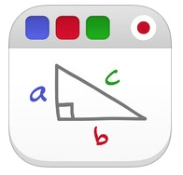
Educreation
Free
Record a lesson with sound
Share by mail or link
Limited database of lessons
Group work
Revision

Slide 48
Knowmia
Free (teacher professional version 26.99€)
Database of lessons
Making of lesson
Student can watch and listen while you are away
Good for flipped classroom

Slide 49
Prezi
Free
Presentation tool
Students seem to prefer it to PPT
Works the same as on PC

Slide 50
Stop and go
Free
Timer in shape of traffic lights
Goes green, then orange and red when finished
You can change the times
Students can use it on own iPad (ownership of task)
Mirror

Slide 51
Voice Record
Recording app
Free
Easy to use
Files can be saved by shared in many ways
Oral preparation at home

Slide 52
Tellagami
Free
Creat gami
Gami = message / scene
Students record the audio or type
Can be shared

Slide 53
iDoceo
Review on lcdsandrinepodcasts.com
Teacher planner
Grade recorder
Roll taker
Behaviour recorder
Not free but worth investment

Slide 54
What’s for year 2?
Keeping my useful apps
Making decision in school to choose one note taking app
Skill training of 1st years at beginning of year
Skill training of teachers in house by level
Sharing of knowledge
Google drive
May be some appsmashing

Slide 55
Useful things
ipad-as-the-teachers-pet
Following #ipad on Twitter
People like: Joe Dale ; Richard Byrne (Free Tech for teachers) ; Larry Ferlazzo

Slide 56
Thank-you!
@sandrinepk
Notes available will be available on:
www.lcdsandrinepodcasts.com
My French teaching website:
www.lcdsandrine.com

